Slide 1

Capstone Project - Supply Chain
N.AISHWARYA
PG-DSBA
November 2022

Slide 2
Presentation Agenda
1
Business problem understanding
2
Exploratory Data Analysis
3
Modeling approach used
4
Model tuning
5
Insights and Recommendations

Slide 3

1
Business Problem Understanding
Business Background: A FMCG company has entered into the instant noodles business two years back. Their higher management has noticed that there is a mismatch in the demand and supply
Problem Scope: The company is incurring inventory loss due to inadequate demand-supply management of its product, instant noodles. Hence, the management needs to optimize the supply quantity (basis demand), across all their warehouses in the country.
Solution Approach: Objective of this project is to build a model using company's historical data, to determine an optimum product weight to be shipped each time to the warehouse. This project compares different popular machine learning classifiers, and measure their performance to identify the most optimal machine learning model to solve this challenge.
The objective is to predict optimum weight of the product to be shipped each time to the warehouse (Supply angle). By coupling with demand prediction, optimal demand-supply will be obtained. Resource optimization and profit maximization will be the derived objectives.

Slide 4
Defining overall approach
EDA – Key Steps
I. Pre-processing of the FMCG data to get it to the ‘right shape’.
1
Derived the necessary columns/ attributes from the data set
2
Dropping variables - Ware_house_ID and WH_Manager_ID
3
Outlier treatment using Interquartile Range (IQR) method
4
Created new variable, “Age group” using imputation and lambda function. This is used to create bins
5
Missing value treatment using KNN imputator
Cleansed Data
“Train and Test Data”
“Decide the prominent metrics”
70% train and 30% test data
Accuracy (RMSE) and R2 are the most important metrics.
Modelling approach and Tuning

Slide 5
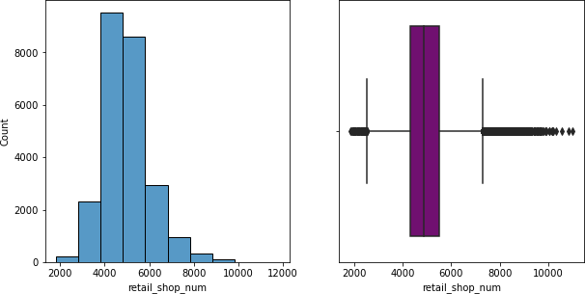
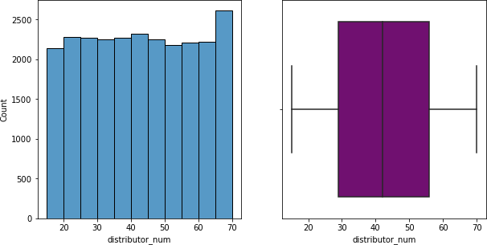
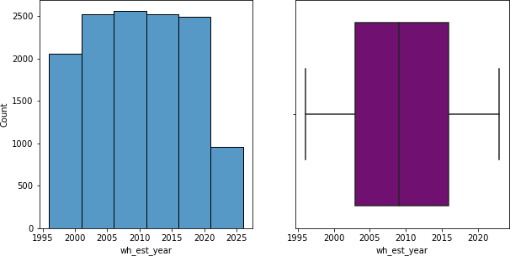
2
Exploratory Data Analysis - Univariate Analysis
Univariate analysis has been done for all 16 variables, the prime ones being highlighted below
Retail Shop - Variable
Distributors - Variable
Warehouses - Variable
Key Observations:
.
Retail shops are right skewed. Having 4000 to 5000 retail shops in normal.
The number of distributors are observed to be fairly uniform across the respective ranges - majority of warehouses have 20 to 40 workers.
It is observed that the majority of warehouses have reported more than 4 breakdowns in past 3 months. The data is left skewed
The number of government checks have been 25 to 30 for most warehouses
Distance from hub is observed to be fairly uniform across the respective ranges

Slide 6
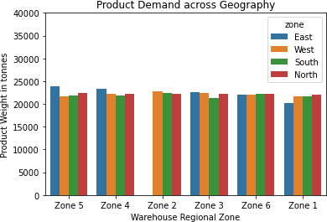
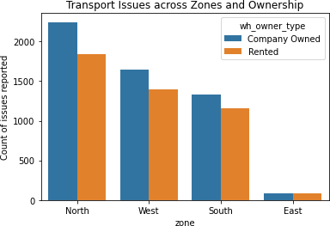
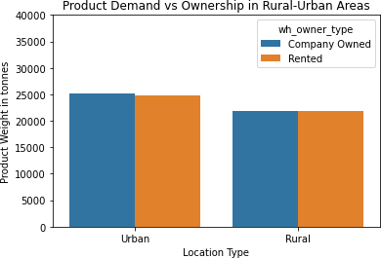
Exploratory Data Analysis - Bivariate Analysis
East zone has no warehouses in Zone 2. In the North and the West, the Zone 6 has the highest number of warehouses.
Further investigation shows that the East zone has fewer number of distributors and retail shops, but more competitors in the market, relative to the other zones.
In summary, East zone has fewer warehouses, retail outlets and distributors. It has much higher number of competitors yet has the same product demand as other zones.
This might be a result of the popularity of the product in this region, encouraging the marketing department to pay greater attention
Warehouse ownership seems to have an impact on the average product weight shipped, which also varies based on its location. Urban company-owned warehouses order more than the rented ones in the same location. In rural areas, this difference is negligible.
Greater number of transport issues have been reported by company-owned warehouses, in comparison to the rented ones.

Slide 7
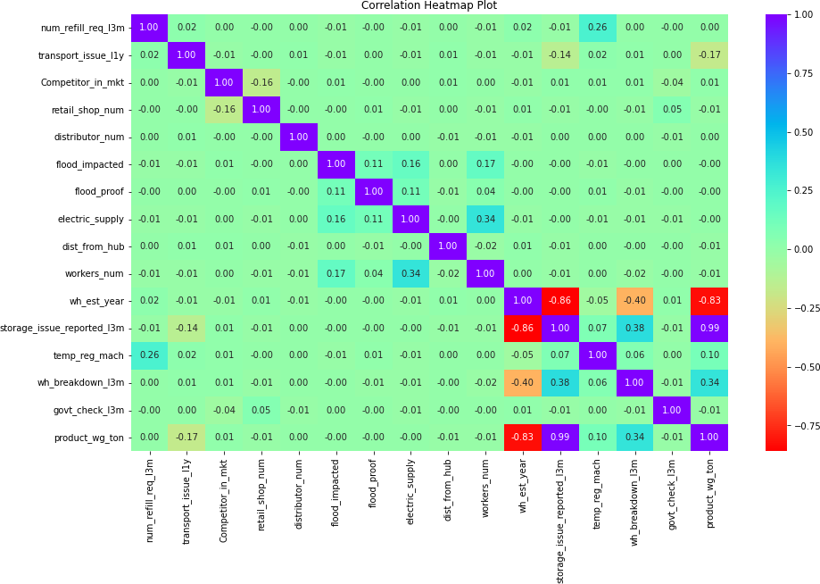
Exploratory Data Analysis - Multivariate Analysis
It is observed that the product demand has a strong positive correlation with the storage issues reported.
The Pearson correlation coefficients calculated for all pairs of continuous variables obtained as a matrix, have been presented as a heatmap. The darker the color, the lower is the magnitude of the correlation.
As can be observed, “storage issues reported in 3 months” column has a high correlation with product weight in tons.

Slide 8
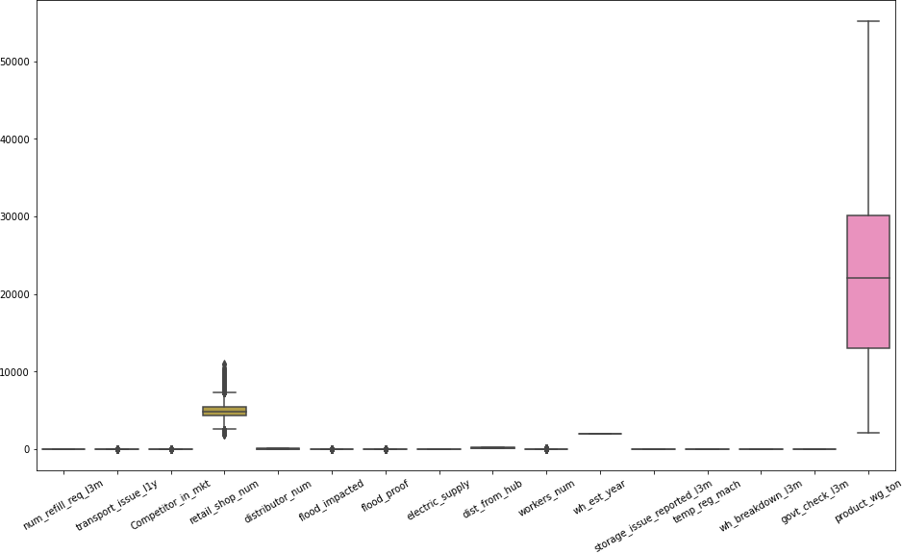

Outlier treatment
EDA has been followed by outlier detection and removal. This is limited to continuous variables. Below are the variables having outliers
Competitor_in_mkt, retail_shop_num, transport_issue_l1y, workers_num, the outlier treatment is done in the further analysis.
Flood_impacted & flood_proof outliers are not treated as they are nominal columns.
Before treating outliers
After treating outliers
The IQR (Interquartile Range) method has been used to detect and remove outliers. IQR is the range between the first and the third quartiles namely Q1 and Q3: IQR = Q3 – Q1.

Slide 9
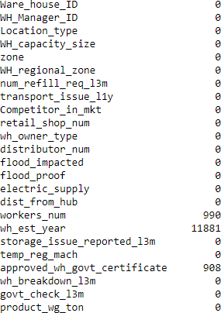
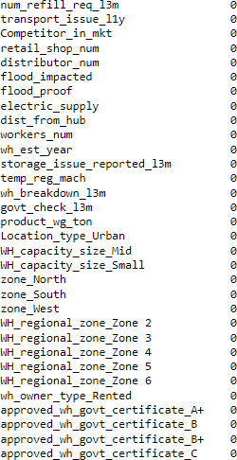
Missing Value treatment
Checking the missing value among all variables
Applied the KNN imputer, to remove the missing values in the dataset
Observations:
'workers_num' variable has 990 missing values.
'wh_est_year' variable has 11881 missing values.
'approved_wh_govt_certificate' variable has 908 missing values.
In total, 2.3% of the data has null values.
Post KNN imputation method, all missing values have been removed.
The number of nearest neighbors to be considered is kept at 1. However, as they are categorical in nature, these are converted to dummy variables eventually. The output after the KNN imputation is shown above (right side)

Slide 10
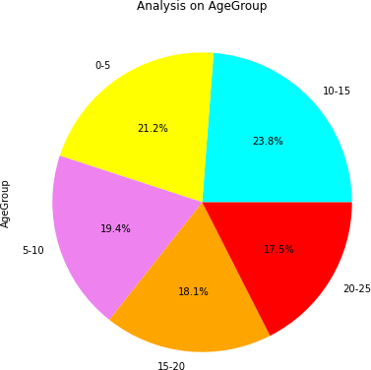
Addition of new variable
Created a new variable, “Age group” by using imputation and lambda function; This is used to create bins -> [0,5,10,15,20,25]
Below is the distribution across the bins of the age group
Bin | Distribution
0-5 | 5,155
5-10 | 4,720
10-15 | 5,789
15-20 | 4,411
20-25 | 4,263

Slide 11
3
Modeling approach used - Feature Selection
Feature Selection:
Feature Selection is the method of reducing the input variable to your model by using only relevant data and getting rid of noise in data. Feature selection can be done in multiple ways but there are broadly 3 categories:
1. Filter Method
2. Wrapper Method
3. Embedded Method
Filter Method
In this method you filter and take only the subset of the relevant features. The model is built after selecting the features. The filtering here is done using correlation matrix and it is most commonly done using Pearson correlation and VIF.
Variance Inflation Factor (VIF):
The Variance Inflation Factor (VIF) measures the severity of multicollinearity in regression analysis. Collinearity is the state where two variables are highly correlated and contain similar information about the variance within a given dataset.
Here we perform the VIF and will remove the variables one by one which are highly correlated and proceeding with the other variable for modelling.

Slide 12
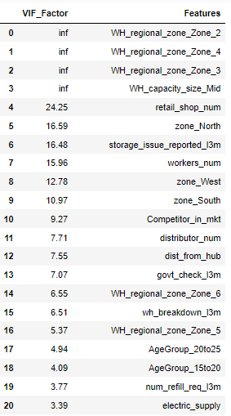
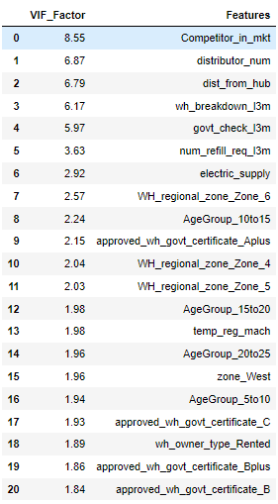
Modeling approach used - VIF Analysis
We set the threshold to 10, as we wish to remove the variable for which the remaining variables explain more than 90% of the variation.
The removed variables include: "WH_regional_zone_Zone_2, retail_shop_num, workers_num, storage_issue_reported_l3m, zone_North" as its still showing VIF value greater than 10

Slide 13
Modeling approach - Comparison of models
Modeling Approach:
Data has been split into X and y into training and test set in 70:30 ratio with random_state=1.
Since this a supervised regression problem the following models have been performed - Linear Regression, LDA, Ridge, Lasso, ANN etc.
Two metrics to measure the model fit include root mean squared error (RMSE) and the R-squared (R2).
Random Forest regressor is the best performing model in comparison to others, prior to hypertuning
 | Train (RMSE) | Test (RMSE) | Training (R2) | Test (R2)
Random Forest Regressor | 2,267.6 | 5,918.1 | 0.96 | 0.74
Ridge Regression | 6,307.4 | 6,110.8 | 0.71 | 0.72
Lasso Regression | 6,307.4 | 6,110.8 | 0.71 | 0.72
Linear Regression | 6,307.4 | 6,110.8 | 0.71 | 0.72
ANN Regressor | 6,270.4 | 6,075.7 | 0.71 | 0.72
Decision Tree Regressor | 0.00 | 8,231.9 | 1.00 | 0.49

Slide 14
Modeling approach used - Ensemble modeling
Ensemble methods are techniques that aim at improving the accuracy of results by combining multiple models. Tried using few of the ensemble models below to see whether the model performs better than base models.
 | Train RMSE | Test RMSE | Training Score | Test Score
Gradient BoostingRegressor | 5,967.9 | 5,819.5 | 0.74 | 0.74
XGB Regressor | 4,380.7 | 5,991.8 | 0.86 | 0.73
Bagging Regressor | 2,684.8 | 6,150.1 | 0.95 | 0.71
AdaBoost Regressor | 6,942.1 | 6,849.0 | 0.64 | 0.65
Within all the ensemble models shown above Gradient Boosting regressor is performing better, followed by XGB Regressor
From the models we could see that warehouse established year, transport issue, warehouse breakdown is few of the importance features effecting the optimum weight shipment.
Later, we will try to tune the models and will see whether the model performance improves.

Slide 15
4
Model Tuning
Hypertuned models results after hypertuning
 | Train RMSE | Test RMSE | Training Score | Test Score
XGB Regressor with GridSearchCV | 5370.7 | 5719.8 | 0.79 | 0.75
Random ForestRegressor with GridSearchCV | 5005.1 | 5740.9 | 0.82 | 0.75
Decision TreeRegressor with GridSearchCV | 5527.6 | 5933.8 | 0.77 | 0.73
ANN Regressor with GridSearchCV | 6270.4 | 6075.7 | 0.71 | 0.72
Lasso Regression with GridSearchCV | 6308.7 | 6110.3 | 0.71 | 0.72
Linear Regression with GridSearchCV | 6307.4 | 6110.8 | 0.71 | 0.72
Ridge Regression with GridSearchCV | 6560.3 | 6398.5 | 0.68 | 0.69
Bagging Regressor with GridSearchCV | 6185.2 | 6707.6 | 0.72 | 0.66
Gradient BoostingRegressor with GridSearchCV | 5535.96 | 5730.60 | 0.77 | 0.75
AdaBoostRegressor with GridSearchCV | 6717.76 | 6535.12 | 0.67 | 0.68
Among all the models performed till now, XGB Regressor & Random Forest are performing well.
We can observe that Gradient boost and Decision Tree regressor has improved.
Ridge, Lasso is not showing much improvement in the score and RMSE after tuning and results of both are almost same. ANN regressor is giving the same values even after performing the hypertuning.

Slide 16
Final Model Comparison
 | Train RMSE | Test RMSE | Training Score | Test Score
XGB Regressor with GridSearchCV | 5,370.7 | 5,719.8 | 0.79 | 0.75
Random Forest Regressor with GridSearchCV | 5,005.1 | 5,740.9 | 0.82 | 0.75
Random Forest Regressor | 2,267.6 | 5,918.1 | 0.96 | 0.74
Decision Tree Regressor with GridSearchCV | 5,527.6 | 5,933.8 | 0.77 | 0.73
XGB Regressor | 4,380.7 | 5,991.8 | 0.86 | 0.73
ANN Regressor | 6,270.4 | 6,075.7 | 0.71 | 0.72
ANN Regressor with GridSearchCV | 6,270.4 | 6,075.7 | 0.71 | 0.72
Lasso Regression with GridSearchCV | 6,308.7 | 6,110.3 | 0.71 | 0.72
Ridge Regression | 6,307.4 | 6,110.8 | 0.71 | 0.72
Lasso Regression | 6,307.4 | 6,110.8 | 0.71 | 0.72
Linear Regression | 6,307.4 | 6,110.8 | 0.71 | 0.72
Linear Regression with GridSearchCV | 6,307.4 | 6,110.8 | 0.71 | 0.72
Bagging Regressor | 2,684.8 | 6,150.1 | 0.95 | 0.71
Ridge Regression with GridSearch CV | 6,560.3 | 6,398.5 | 0.68 | 0.69
Bagging Regressor with GridSearchCV | 6,185.2 | 6,707.6 | 0.72 | 0.66
AdaBoost Regressor | 6,942.1 | 6,849.0 | 0.64 | 0.65
Decision Tree Regressor | - | 8,232.0 | 1 | 0.49
Gradient BoostingRegressor with GridSearchCV | 5,535.9 | 5,730.6 | 0.77 | 0.75
Gradient Boosting Regressor | 5,967.9 | 5,819.5 | 0.74 | 0.74
AdaBoost Regressor with GridSearchCV | 6,717.8 | 6,535.1 | 0.67 | 0.68

Slide 17
Interpretation of the most optimum model
Comparing all the model performed, the most optimal model is Random Forest regressor – this gives 82% accuracy In Train & 75% in Test with RMSE value of Train as 5,005 & Train as 5,741
Implication to the business
Below features have maximum effect on optimum weight (product_wg_ton):
Warehouse Breakdown in last 3 months.
Transport issue.
Refilling time in last 3 months.
Warehouse established year.
The warehouse breakdowns due to both internal & external factors results on its inventory management & leading manufactures.
Accident or Product stolen shall be another factor which can lead to optimum weight mismatch at the time of delivery, resulting in supply constraints
Delay in stock refilling hampers reduced stock during high demand times
Features that affect product_wg_ton which specifies the optimum weight of the product to be shipped are Warehouse that are established at least 5 years ago and its importance increases with the age of warehouse.

Slide 18
5
Insights and Recommendations
STRATEGIC
Improved strategic KPIs
Strategic KPIs such as Customer Service Level and improved fill rates needs to be improved using better demand planning and forecasting.
STRATEGIC
Improved strategic focus
East zone’s product demand is on par with other zones, however with increased competition. However, the zone has fewer
OPERATIONAL
Operational streamlining
Review policies and procedures to ensure efficiency and compliance. It also helps avoid bottlenecks in the supply chain, streamline operations and mitigate the risks of theft and fraud. Regular reviews help in identifying different risk elements and estimating their financial impact
Warehouse operations needs to be aligned to deliver inventory management and accurate inventory records. This helps to know whenever there is a refill required immediately and won’t affect supply
Hence it is critical to focus on improving more focus on this zone, by enhancing the product fulfillment experience.
warehouses, retail outlets and distributors.

Slide 19
Insights and Recommendations
OPERATIONAL
Warehouse efficiency
TACTICAL
Distribution
Need to perform frequent audits upon warehouse operation standards. Use technology to improve the supply chain. Review all the existing processes that are affecting the inventory management. Determine the areas where implementing technology could improve the processes.
Set up a governing council that offers a clear strategy for functionality and efficiency, thus reducing Warehouse breakdown factors. The council’s aim is to give directions and align the supply chain strategy with the company’s core goals. The council helps in removing barriers within the organization.
Distribution from hub is a key feature identified in impacting the business – hence improved logistics scheduling can play a key role for improvement in this area.

Slide 20
Thank You!

